Slide 1
ROS 教程5
編寫人:李彥霆

Slide 2

目錄
ROS lauch編寫

Slide 3
本節前置: # roscd beginner_tutorials 查看是否有新增過pkg

Slide 4
建立Package
$ catkin_create_pkg beginner_tutorials std_msgs rospy roscpp
$ cd ~/catkin_ws
$ catkin_make
$ . ~/catkin_ws/devel/setup.bash
$ source /root/catkin_ws/devel/setup.bash

Slide 5
ROS lauch編寫

Slide 6
ROS lauch編寫
$ mkdir launch
$ cd launch
$ vim turtlemimic.launch

Slide 7
ROS lauch編寫
<launch>
<group ns="turtlesim1">
<node pkg="turtlesim" name="sim" type="turtlesim_node"/>
</group>
<group ns="turtlesim2">
<node pkg="turtlesim" name="sim" type="turtlesim_node"/>
</group>
<node pkg="turtlesim" name="mimic" type="mimic">
<remap from="input" to="turtlesim1/turtle1"/>
<remap from="output" to="turtlesim2/turtle1"/>
</node>
</launch>

Slide 8
ROS lauch編寫 解說
<launch>
## 創立group= turtlesim1
<group ns="turtlesim1">
<node pkg="turtlesim" name="sim" type="turtlesim_node"/>
</group>
## 創立group= turtlesim2
<group ns="turtlesim2">
<node pkg="turtlesim" name="sim" type="turtlesim_node"/>
</group>
<node pkg=“turtlesim” name=“mimic” type=“mimic”> ##建立node
<remap from=“input” to=“turtlesim1/turtle1”/> ##由turtlesim1作Input
<remap from="output" to="turtlesim2/turtle1"/> ##由turtlesim2作Output
</node>
</launch>

Slide 9
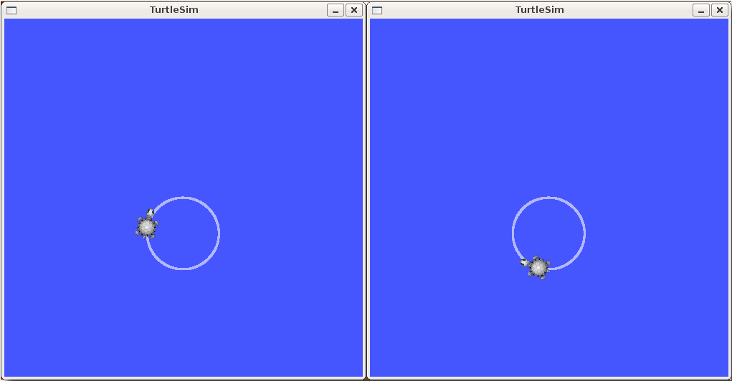
ROS lauch編寫
$ roslaunch beginner_tutorials turtlemimic.launch
開新終端機
$ rostopic pub /turtlesim1/turtle1/cmd_vel geometry_msgs/Twist -r 1 -- '[2.0, 0.0, 0.0]' '[0.0, 0.0, -1.8]‘
因為mimic的關係，會發現兩個烏龜都在動。

Slide 10
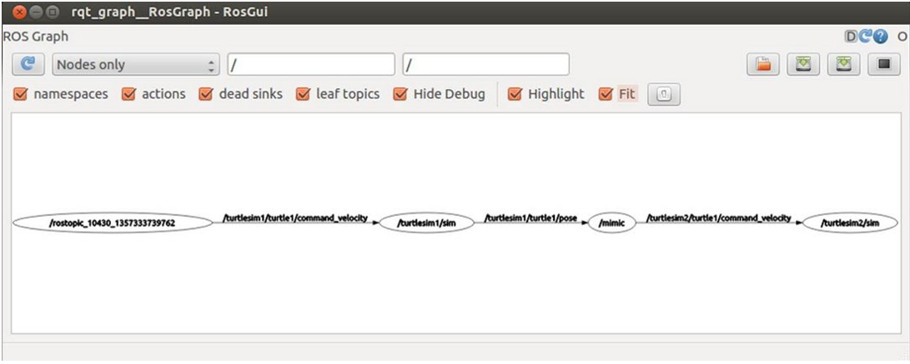
ROS lauch編寫
$ rqt_graph

Slide 11
參考資料
Understanding ROS Services and Parameters
http://wiki.ros.org/ROS/Tutorials/UnderstandingServicesParams
TKTim/Ros_Tutorial
https://github.com/TKTim/Ros_Tutorial/tree/master/%E5%9C%96%E5%BD%A2%E5%8C%96Node%E9%97%9C%E4%BF%82

